Slide 1
Health Care Analytics

Slide 2
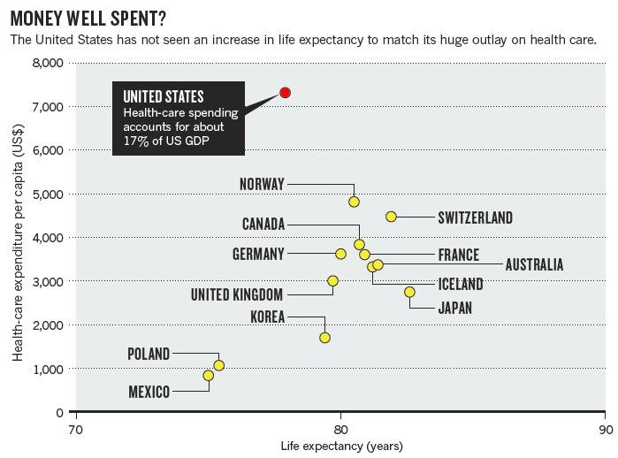
Motivation
Can we learn from the past to become better in the future ??
Healthcare Data is
becoming
more
complex
!!
In 2012, worldwide digital healthcare data was estimated to be equal to 500 petabytes and is expected to reach 25,000 petabytes in 2020.
Hersh, W., Jacko, J. A., Greenes, R., Tan, J., Janies, D., Embi, P. J., & Payne, P. R. (2011). Health-care hit or miss? Nature, 470(7334), 327.
2

Slide 3
Definition of Big Data
▪
A collection of large and complex data sets which are difficult to
process
using common database management tools
processing applications.
“Big data refers to the tools, processes and procedures allowing an organization to create, manipulate, and manage very
or
traditional
data
Volume
▪
large
data
sets and storage facilities”
–
according
to
zdnet.com
Velocity
Variety
Big data is not just about size.
• Finds insights from complex, noisy, heterogeneous, longitudinal, and voluminous data.
• It aims to answer questions that were previously unanswered.
The challenges include capturing, storing, searching, sharing & analyzing.
Veracity
The four dimensions (V’s) of Big Data
5

Slide 4
Introduction
Healthcare costs
Quality of care to patients – Not seen considerable improvements.
Incorporating the new healthcare technologies can reduce mortality rates, healthcare costs, and medical complications at various hospitals.
US government enacted the Health Information Technology for Economic and Clinical Health Act (HITECH) for the adoption and meaningful use of Electronic Health Records (EHRs).

Slide 5
Introduction
Healthcare data derived from sensors, images, text in the form of biomedical literature/clinical notes, and traditional electronic records.
Heterogeneity leads to challenges
Diversity of technique requirement in collection and representation.
Integration.
Understanding underlying data.
Interdisciplinary nature.
So independent lines of work from completely different perspectives.
Isolated from real domain-speciﬁc problems.
Problem with excellent technique but with no practical use.

Slide 6
Healthcare Data Sources and Basic Analytics

Slide 7
Electronic Health Records
Digitized version of a patient’s medical history which contains demographics, problems, medications, physician’s observations, vital signs, medical history, laboratory data, radiology reports, progress notes, and billing data.
Provide an effective and efficient way for healthcare providers and organizations to share with one another.
Designed to be in real time and they can instantly be accessed and edited by authorized users.
It can generate a complete record of a patient’s clinical encounter, and support other care-related activities such as evidence-based decision support, quality management, and outcomes reporting.
The storage and retrieval of health-related data is more efficient using EHRs.
It helps to improve quality and convenience of patient care, increase patient participation in the healthcare process, improve accuracy of diagnoses and health outcomes, and improve care coordination.

Slide 8
Biomedical Image Analysis
Biomedical image analysis is to be able to generate quantitative information and make inferences from the images that can provide far more insights into a medical condition.
Most popular imaging modalities used to acquire a biomedical image
Magnetic resonance imaging (MRI), computed tomography (CT), positron emission tomography (PET), and ultrasound (U/S).
Being able to look inside of the body without hurting the patient and being able to view the human organs.
Challenges
The images are varied,
complex,
Can contain irregular shapes with noisy values.
Research Problems
Analyzing images are object detection,
Image segmentation,
Image registration,
Feature extraction.

Slide 9
Sensor Data Analysis
Sensor data is ubiquitous in the medical domain both for real time and for retrospective analysis.
Several forms of medical data collection instruments
Electrocardiogram (ECG),
Electroencaphalogram (EEG)
Use Case - real-time analysis
Intensive care units (ICUs) and real-time remote monitoring of patients with speciﬁc medical conditions.
Huge Volume of data to be processed
Analytics will be both the real-time events and a long-term analysis.

Slide 10
Biomedical Signal Analysis
Measuring signals from biological sources.
The measurement of physiological signals gives some form of quantitative or relative assessment of the state of the human body.
Examples of signals include the electroneurogram (ENG), electromyogram (EMG), electrocardiogram (ECG), electroencephalogram (EEG), electrogastrogram (EGG), phonocardiogram (PCG), and so on.
Challenging due to the low signal-to-noise ratio (SNR) and the interdependency of the physiological systems.
Require a signiﬁcant amount of preprocessing as contain lot of Noise.
Several signal processing algorithms have been developed.
A wide variety of methods are used for ﬁltering, noise removal, and compact methods.
Dimensionality reduction techniques such as Principal Component Analysis (PCA), Singular Value Decomposition (SVD), and wavelet transformation have also been widely investigated in the literature.

Slide 11
Genomic Data Analysis
Nature of the causality between the genetic markers and the diseases has not been fully established.
For example, diabetes - the full set of genetic markers that make an individual prone to diabetes are unknown. Blindness caused by Stargardt disease, the relevant genes are known but all the possible mutations have not been exhaustively isolated.
Genetic data are often modeled either as sequences or as networks.
Various data analytics-based solutions in medicine such as
identiﬁcation of disease biomarkers and therapeutic targets and prediction of clinical outcome.

Slide 12
Clinical Text Mining
Clinical notes are typically stored in an unstructured data format and is the backbone of much of healthcare data.
These contain the clinical information from the transcription of dictations, direct entry by providers, or use of speech recognition applications.
Challenge : Converting free-text to a structured format.
Varying context across different patients and practitioners.
Natural language processing (NLP) and entity extraction play an important part in inferring useful knowledge .
Processing of other texts due to the ungrammatical nature of short and telegraphic phrases, dictations, shorthand lexicons such as abbreviations and acronyms, and often misspelled clinical terms.

Slide 13
Social Media Analysis
Public opinion on various aspects of healthcare.
Population health and public health monitoring.
Although most individual messages may contain little informational value, aggregation of millions of such messages can generate important knowledge.
Research focused on capturing aggregate health trends such as outbreaks of infectious diseases, detecting reports of adverse drug interactions, and improving interventional capabilities for health-related activities.
Disease outbreak detection →an analysis of the history of the content provides valuable insights about disease outbreaks.
Topic models are frequently used for high-level analysis of such health-related content.
An additional source of information in social media sites is obtained from online doctor and patient communities.
Since medical conditions recur across different individuals, the online communities provide a valuable source of knowledge about various medical conditions.
A major challenge in social media analysis is that the data is often unreliable, and therefore the results must be interpreted with caution.

Slide 14
SOURCES AND TECHNIQUES FOR BIG DATA IN HEALTHCARE

Slide 15
Electronic Health Records: A Survey

Slide 16
Introduction
Digital version of a patient’s medical history.
Interchangeably with EMR (Electronic Medical Record) and CPR (Computer-based Patient Record).
Data relevant to a patient’s care.

Slide 17
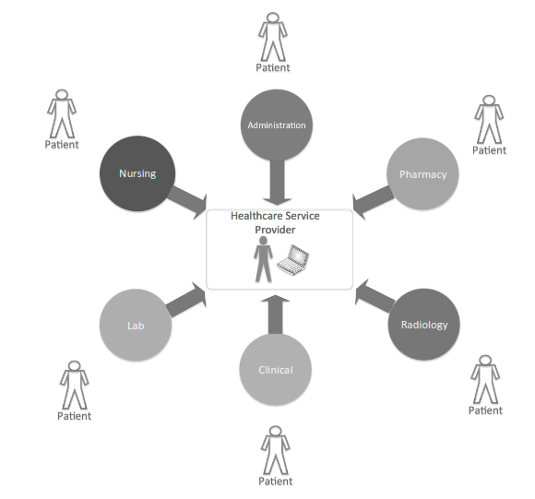
Various components of EHR.

Slide 18

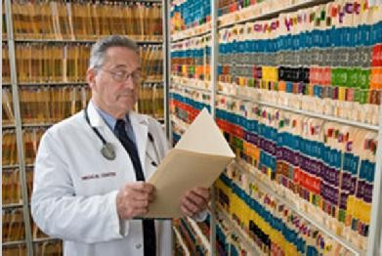
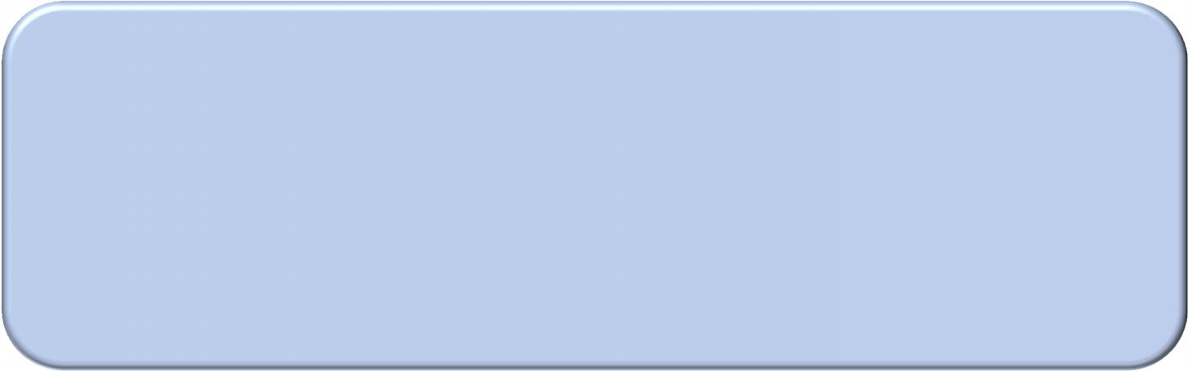
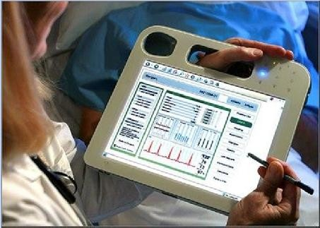
Healthcare Analytics using Electronic Health Records (EHR)
▪ Old way: Data are expensive and small
– Input data are from clinical trials, which is small and costly
– Modeling effort is small since the data is
limited
• A single model
can
still
take
months
▪
EHR era: Data are cheap and
large
–
–
–
–
–
Broader patient population
Noisy data Heterogeneous data Diverse scale Complex use cases
Jimeng Sun, Large-scale Healthcare Analytics

Slide 19
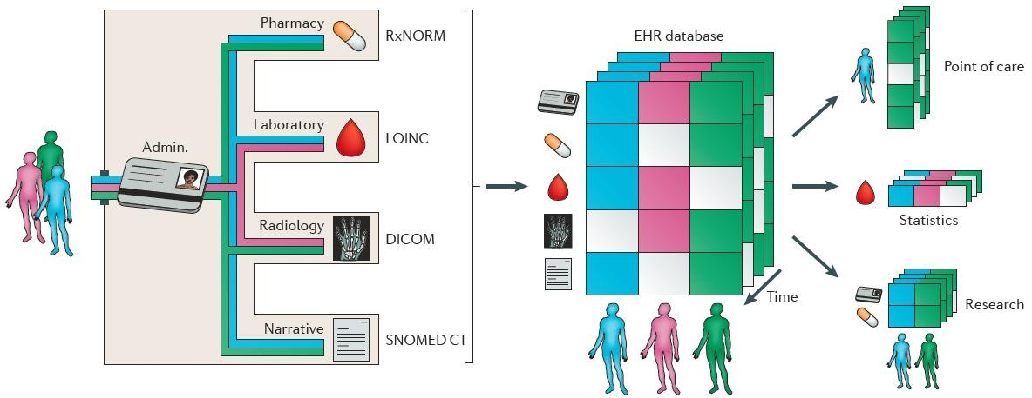
Data Collection and Analysis
Effectively integrating and efficiently analyzing various forms of healthcare data over
a period of time can answer many of the impending healthcare problems.
Jensen, Peter B., Lars J. Jensen, and Søren Brunak. "Mining electronic health records: towards better research applications and clinical care." Nature Reviews Genetics (2012).

Slide 20



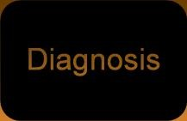



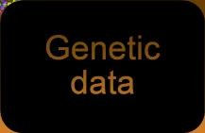
















Heterogeneous Medical Data
Diagnosis
Diagnosis
Genetic data
Genetic data
Medication
Medication
Images
Lab
Images
Lab
Clinical notes
Clinical notes
Jimeng Sun, Large-scale Healthcare Analytics

Slide 21

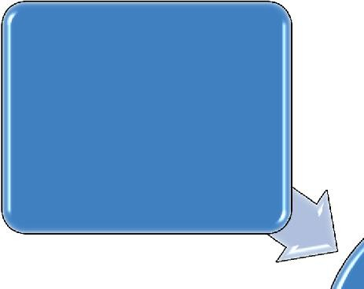


Data
Clinical data
•
•
Structured EHR
Unstructured
EHR
Medical Images
Genomic data
•
Behavior data
•
DNA sequences
•
Social network data
•
Mobility data
sensor
Health data
22

Slide 22

Billing data - ICD codes
▪
▪
ICD stands for International Classification of Diseases
ICD is a hierarchical terminology of diseases, signs, symptoms, and procedure codes maintained by the World Health Organization (WHO)
In US, most people use ICD-9, and the rest of world use ICD-10
Pros: Universally available
Cons: medium recall and medium precision for characterizing patients
▪
▪
▪
•
(250) Diabetes mellitus
•
•
•
•
•
•
•
•
•
•
(250.0) Diabetes mellitus without mention of complication
(250.1) Diabetes with ketoacidosis (250.2) Diabetes with hyperosmolarity (250.3) Diabetes with other coma
(250.4) Diabetes with renal manifestations
(250.5) Diabetes with ophthalmic manifestations (250.6) Diabetes with neurological manifestations (250.7) Diabetes with peripheral circulatory disorders (250.8) Diabetes with other specified manifestations (250.9) Diabetes with unspecified complication
23

Slide 23

Billing data – CPT codes
▪
CPT stands for Current Procedural Terminology created
American Medical Association
by
the
▪
▪
▪
CPT is used for billing purposes
Pros: High precision
for clinical services
Cons:
Low recall
Codes for Evaluation and Management: 99201-99499
(99201 - 99215) office/other outpatient services (99217 - 99220) hospital observation services (99221 - 99239) hospital inpatient services (99241 - 99255) consultations
(99281 - 99288) emergency dept services
(99291 - 99292) critical care services
…
24

Slide 24
Lab results
▪
The standard code for lab is Logical Observation Identifiers Names and Codes
(LOINC®)
Challenges for lab
▪
–
–
Many lab systems still use local dictionaries to encode labs
Diverse numeric scales on different labs
•
Often need to map to normal, low or high ranges in order to be useful for
analytics
–
Missing data
•
•
not all patients have all labs
The order of a lab test can be predictive, for example, BNP indicates high likelihood of heart failure
Time Lab Value
1996-03-15 12:50:00.0 CO2 29.0
1996-03-15 12:50:00.0 BUN 16.0
1996-03-15 12:50:00.0 HDL-C 37.0
1996-03-15 12:50:00.0 K 4.5
1996-03-15 12:50:00.0 Cl 102.0
1996-03-15 12:50:00.0 Gluc 86.0
25

Slide 25
Medication
▪
Standard code is National Drug Code (NDC) by Food and Drug
Administration (FDA), which gives a unique identifier for each drug
– Not used universally by EHR systems
– Too specific, drugs with the same ingredients but different brands have different NDC
RxNorm: a normalized naming system for generic and branded drugs by National Library of Medicine
Medication data can vary in EHR systems
– can be in both structured or unstructured forms
Availability and completeness of medication data vary
– Inpatient medication data are complete, but outpatient medication data are not
– Medication usually only store prescriptions but we are not sure whether patients actually filled those prescriptions
▪
▪
▪
26

Slide 26
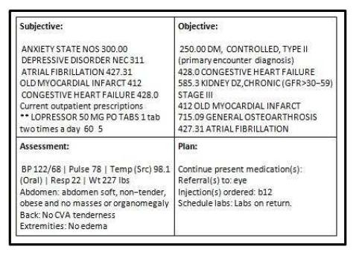
Clinical notes
▪
▪
Clinical notes contain rich and diverse source of
Challenges for handling clinical notes
information
–
–
–
–
Ungrammatical, short phrases
Abbreviations
Misspellings
Semi-structured information
• Copy-paste from other structure source
– Lab results, vital signs
• Structured template:
– SOAP notes: Subjective, Objective, Assessment, Plan
27

Slide 27
Privacy-Preserving Data Publishing Methods in Healthcare

Slide 28
Introduction
Sharing personal health information can bring enormous economical beneﬁts.
Applying analytics on huge data will provide an improved outcome but sharing will affect the individual privacy.
EHR enables to share the health data.
Health Insurance Portability and Accountability Act (HIPAA).
In US 75% of patients have expressed concerns about uninformed sharing of their health information.

Slide 29
Definition
A person’s right and desire to control the disclosure of their personal health information
Health information ranges from a person’s identity to disease/medication history.
Sometimes covers organizational information such as hospitals and insurance companies.
Popular privacy metrics
k-anonymity, l-diversity, and e-differential privacy.

Slide 30
Applying PPA to healthcare data
Steps for privacy-preserving data publication algorithms:
1. Identifying an appropriate privacy metric and level for a given access setting and data characteristics
2. Applying one or multiple privacy-preserving algorithm(s) to achieve the desired privacy level
3. Post analyzing the utility of the processed data
4. Repeating this cycle (from 1 to 3) until the desired utility and privacy levels are jointly met
Multiple privacy-preserving algorithms are applied before publishing.
For example, 6 different methods: (1) variable reduction, (2) suppression, (3) substitution, (4) imputation, (5) data perturbation, and (6) coarsening

Slide 31
Data Overview and Preprocessing
Texas Inpatient Public Use Data File - Fourth quarter of 2006
Each yearly dataset contains about 2.8 millions events with more than 250 features.
Natural delivery events from Parkland Memorial Hospital.
The dataset is already anonymized, and does not contain any identifiable information such as name, social security number, and driver license number.

Slide 32
Outlier Removal, Variable Reduction, and Coarsening
Modeling the relationship between demographic factors (sex, address), insurance, and hospital charges.
Objective is to publish this dataset for the specified research objective while protecting patients’ privacy.

Slide 33
Privacy-Preserving Publishing Methods
Three different kinds of privacy-preserving algorithms:
Generalization/suppression,
Creation of synthetic data, and
Perturbed synthetic data.

Slide 34
Generalization and Suppression
To remove any personal identifiable variables such as name, telephone number, social security number, and driving license number.
“linking attack.”
A dataset from the Group Insurance Commission (GIC) and the voter registration list.
Common variables: zip code, birth date, and sex.
By linking the two datasets person can be identified.

Slide 35
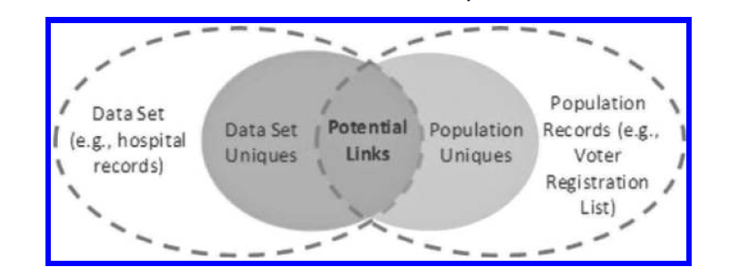
Link Attack

Slide 36
Generalization and Suppression
Generalization replaces a value with a less specific but semantically consistent value.
For example, a zip code can be generalized into city or county.
Suppression replaces a value to a non-informative value, e.g., 600127 → *.

Slide 37
Quasi-identifier
Even after removable of identifiable variables, if certain combination of variables can be unique, and this may potentially lead to privacy breach incidents.
A quasi-identifier is a set of variables within a dataset that may be empirically unique.
Eg : set of sex, geographical code, and payment source.
k-anonymity to formalize and quantify the disclosure risk of unique populations.
Latanya Sweeney. Achieving k-anonymity privacy protection using generalization and suppression. International Journal on Uncertainty, Fuzziness and Knowledge-Based Systems, 10(5):571–588, 2002.
Latanya Sweeney. k-anonymity: A model for protecting privacy. International Journal on Uncertain, Fuzziness and Knowledge-Based Systems, 10:557–570, October 2002.

Slide 38
Synthetic Data Using Multiple Imputation
The generation of synthetic data is an alternative (and sometimes complementary) approach to data transforming disclosure techniques.
Multiple imputation, which was originally developed to impute missing values in survey responses, can also be used to generate either partially or fully synthetic data.
Donald B. Rubin. Multiple Imputation for Nonresponse in Surveys. Wiley, 1987.
Donald B. Rubin. Discussion: Statistical disclosure limitation. Journal of Official Statistics, 9:462–468, 1993.

Slide 39
PeGS: Perturbed Gibbs Sampler
Synthetic data need to be accurate enough to answer relevant statistical queries without revealing private information to third parties.
Statistical properties of synthetic data are primarily determined by imputation models, and models that are too accurate tend to leak private information.
The disclosure risks of multiply imputed synthetic datasets are typically measured after synthetic datasets are generated, i.e., using post hoc risk analysis.
Multiple imputation is a general imputation methodology, and the choice of posterior model is usually up to statisticians.
This flexibility makes it difficult to apply and analyze rigorous privacy measures, such as differential privacy and l-diversity, in a unified framework.
Park and Ghosh (2014) were able to address this limitation by deriving the relationship between the amount of Laplace smoothing and privacy measures (e in differential privacy and l in l-diversity) using a simple non-parametric model.
They then directly incorporated these privacy measures in the synthesizing process, guaranteeing the desired level of privacy for synthetic data.
The resulting Perturbed Gibbs Sampler (PeGS) is a practical multidimensional categorical data synthesizer that satisfies e-differential privacy.
It can handle multidimensional data that are not practical to be represented as contingency tables.

Slide 40
Randomization Methods
The generation of synthetic data can be viewed as a special case of the “randomization method.”
Example, additive noise, probabilistic value mapping and suppression, and sampling from (perturbed) distributions.
Mainly developed in the database and data mining communities.
Although randomization methods are straightforward and easy to apply, it is difficult to quantify the level of privacy.

Slide 41
Data Swapping
Sensitive values are exchanged among individuals while maintaining lower-order frequency counts and marginals.
This transformation not only protects confidentiality by de-correlating sensitive values with the other values, but also keeps a certain level of data utility by preserving summary statistics of the data.
In practice, use a combination of multiple privacy-preserving methods to mitigate potential risks.

Slide 42
Social Media Analytics for Healthcare
Web 4. 0
Some Statistics :
61% of American adults seek health information online.
37% have accessed or posted health information online.
72% of online adults in the United States are using social media.
Of adult social media users, 23% follow their friends’ personal health experiences or updates, 17% use social media to remember and memoralize people with a specific health condition and 15% obtain health information from social media sites .

Slide 43
Research area
Methods for capturing aggregate health trends from social media data, such as outbreaks of infectious diseases, and analyzing the mechanisms underlying the spread of infectious diseases;
Methods for fine-grained analysis and processing of social media data, such as methods to detect reports of adverse drug interactions and medical events and to model the health status and well-being of individuals;
Studying how social media can be effectively used as a communication medium between patients, between patients and doctors and how to effectively leverage social media in interventions and health education campaigns.

Slide 44
Social Media Analysis for Detection and Tracking of Infectious Disease Outbreaks
Epidemics of infectious diseases, such as influenza and cholera, are a major public health concern that is difficult to anticipate and model
Influenza - reoccurs each season in regular cycles, geographic location, timing and size of each outbreak varies, so it is difficult to apply traditional methods like time series analysis.
Public health monitoring has traditionally relied on surveys and aggregating primary data from healthcare providers and pharmacists .
Sentinel surveillance - Surveillance Scheme continuously collect virological and clinical reports from designated laboratories

Slide 45
Cont..
FluView. – www.cdc.gov/flu/weekly
ILINet - Issues weekly reports related to influenza-like illness symptoms
Challenge: Survey-based surveillance systems are effective but typically incur high operational costs and temporal lags in reporting.
Quickly confine infected individuals to their homes in urban is important but sentinel based system suffers with time lag from population bias (since people who do not actively seek treatment or do not respond to surveys).
Social media data are available in near real time.
Geographical metadata can play an important role in monitoring the impact and the geographical spread of an epidemic.

Slide 46
Outbreak Detection
“Health information seeking” for syndromic surveillance.
Eg: 1. Volume of calls to telephone health advisory lines, 2. Over the counter drug sales and 3. School absenteeism rates.
Emergence of a new area of research at the intersection of computer science and public health known as “infodemiology” or “information epidemiology”.
Infodemiology is an umbrella term for methods that study the determinants and distribution of health information for public health purposes and are aiming at:
Developing methodologies and measures to understand patterns and trends for general public health research;
Identifying disease outbreaks based on the analysis of these trends;
Studying and quantifying knowledge translation gaps;
Understanding the predictive value of search and content generation behavior for syndromic surveillance and early detection of emerging diseases.
Detect outbreaks of infectious diseases meta data of different types of online services, such as query logs, microblogs and blogs.

Slide 47
Using Search Query and Website Access Logs
113 million people in the US use the Internet to find health-related information with up to 8 million people searching on a typical day.
So tracking health information-seeking behavior of people over time can be used to monitor public health in general and for syndromic Surveillance.
Analysis of query logs of search engines.
Geographical information (generally based on the IP address of the computer, from which a particular query was issued), it may also be possible to detect simple geo-spatial patterns.
Google advertisement campaign, in which the advertisements were triggered by the influenza-related search terms and experimented with different multivariate models to predict the number of ILI cases based on the advertisement campaign statistics.

Slide 48
Clicks on online advertisements has the highest correlation with traditional surveillance measures.
So systematic mining of search engine logs could be a valuable addition to traditional surveillance methods.

Slide 49
Jeremy Ginsberg, Matthew H. Mohebbi, Rajan S. Patel, Lynnette Brammer, Mark S. Smolinski, and Larry Brilliant. Detecting influenza epidemics using search engine query data. Nature, 457(7232):1012–1014, 2008.
AnalyzedGoogle search engine between 2003 and 2008.
Developed Linear regression model to predict the log-odds of the percentage of ILI-related physician visits.
Pearson correlation coefficient of 0.97 with the CDC-reported ILI statistics.
Google Flu Trends service
Daily basis, up to 7 to 10 days faster than CDC’s FluView .
Challenges
Suffer from population bias, as they are restricted to the sample of individuals, who search the Internet for certain types of content when sick.

Slide 50
Camille Pelat, Clement Turbelin, Avner Bar-Hen, Antoine Flahault, and Alain-Jacques Valleron. More diseases tracked by using Google trends. Emerging Infectious Diseases, 15(8):1327–1328, 2009.
Compared the search trends related to 3 infectious diseases with clinical surveillance data from the French Sentinel Network.
Correlation coefficients of 0.82 for influenza-like illnesses
0.9 for gastroenteritis
0.78 for chickenpox.
Influenza and gastroenteritis was achieved without any time lag, while the time series of searches for chickenpox was lagging one week behind the incidence time series.

Slide 51
https://www.youtube.com/watch?v=I1DFv8t192c&feature=youtu.be
https://www.youtube.com/watch?v=Zh6Atq6besI&feature=youtu.be

Slide 52
Clinical Decision Support Systems (CDSS)
Designed to assist clinicians with patient-related decision making, such as diagnosis and treatment.
CDSS have shown to improve both patient outcomes and cost of care.
To minimize analytical errors by notifying the physician of potentially harmful drug interactions, and their diagnostic procedures have been shown to enable more accurate diagnoses.
Some of the main uses include:
Assisting with patient-related decision making.
Determining optimal treatment strategies for individual patients.
Aiding general health policies by estimating the clinical and economic outcomes of different treatment methods.
Estimating treatment outcomes under circumstances where methods like randomized trials are either impossible or infeasible.
The CDSS features attributed to the analysis’ success included:
natural integration with clinical workflow.
electronic nature.
providing decision support at the time/location of care rather than before or after the patient encounter.
use of recommended care rather than assessments of care.

Slide 53
Various Types of CDSS – Knowledge-Based CDSS
A computer could (theoretically) mimic the thought processes of a real-life clinician and then give a finalized diagnosis based on the information at hand.
Use traditional AI methods (such as conditional logic) to reach decisions on courses of treatment.
Challenges
Underlying fear of computers being inherently prone to errors.
realization that artificial intelligence still had a long way to go before it could successfully mimic
Three main parts
1. knowledge base, 2. Inference engine, and 3. user communication method.
Compiled information set, with structured form of IF-THEN rules.
To put it simply, the user inputs patient information, and then the system searches through its knowledge base for matching diseases or treatment possibilities.

Slide 54
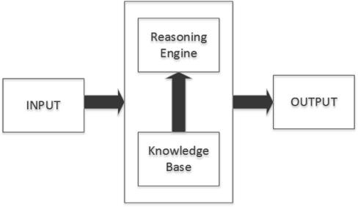
A general knowledge-based clinical decision support system

Slide 55
CDSS Development
CDSS development is very time consuming, so reusability is key but very difficult or impossible to use them beyond their intended purpose.
User communication method is where the clinician herself inputs the patient’s relevant data and then receives the corresponding results.
manually entered.
Either by the clinician or an external lab or pharmacy
Clinician’s job is to properly manipulate the system to obtain the outcome she wishes.
Diagnostic and treatment outcomes are recommendations or alerts.

Slide 56
Inference Engine
The inference engine applies a system of logic to the knowledge base, allowing it to “become smarter” by establishing new and/or updated knowledge.
Eg: Bayes Model

Slide 57
Knowledge Base
The knowledge base contains all necessary medical information along with any rules or conditions necessary for analysis.
For example, medical knowledge must be encoded with probabilistic estimates for the use of Bayes Theorem.
There are four forms of knowledge representation:
logic, procedural, graph/network, and structured systems.

Slide 58
Output
The output of a CDSS is generally in the form of a probabilistically ranked list of solutions.
Generally, this list is in ASCII text format, but it may also be graphical.
In some cases, factors other than probability are used in the ranking process. For example, in DXplain, diseases that are not necessarily likely but very risky when misdiagnosed are given special rank privileges.
In fact, generally speaking, physicians are more interested in the least likely diagnoses than in the most likely ones, since less likely diagnoses are much easier to overlook.

Slide 59
Nonknowledge-Based CDSS
Implement a form of artificial intelligence called Machine Learning.
Learns from Past experience rather than consulting a precomposed encyclopedia,.
Two popular types of Nonknowledge-based CDSSs:
Artificial Neural Networks
Genetic Algorithms

